Slide 1

Project Name :- Cars dataset
Student Name :- Jaswanth sai
http://aiclub.world

Slide 2
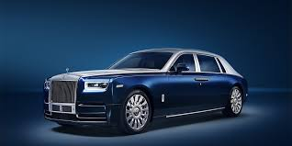
Project Name
Project Description :-
Finding the types of the car
companies

Slide 3
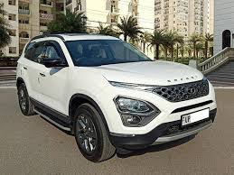
Dataset
Number of samples:
Number of features:
Problem type: Classification
120 samples
4 categories

Slide 4
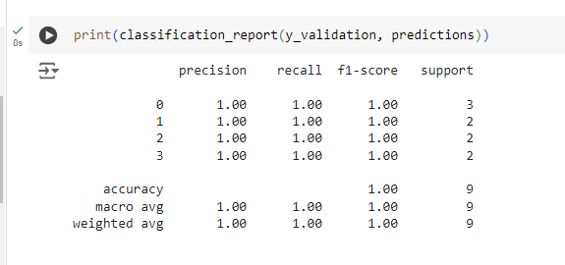
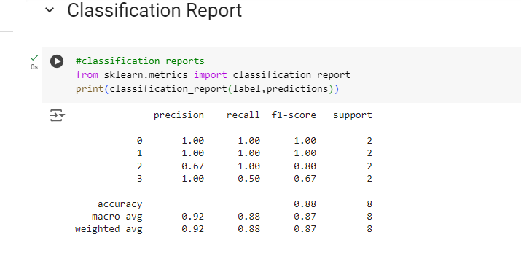
Metrics
My AI did good performance on my dataset .
It gives 100% accuracy and it classifies the types of cars companies

Slide 5
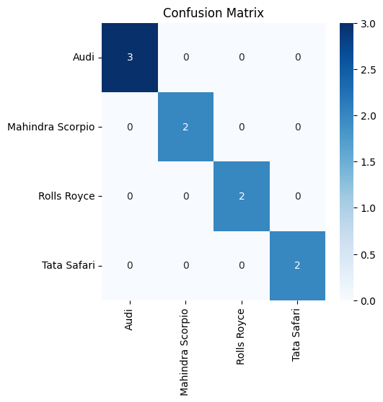
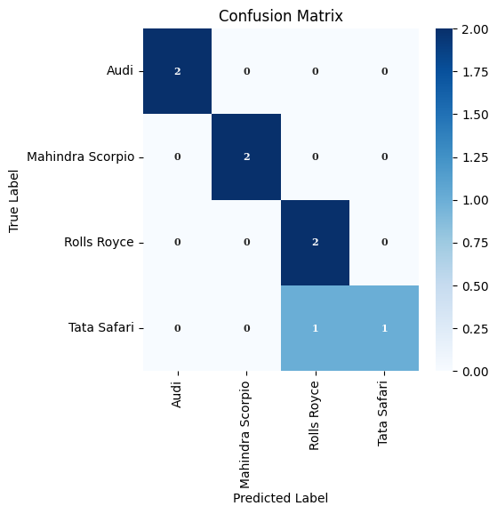
Algorithms (Advanced Classes Only)
Resnet(experimentally)
Algorithm Description:-
Image
classification
Resnet(experimentally)
MobilenetV2(used)
MobilenetV2
(used)

Slide 6
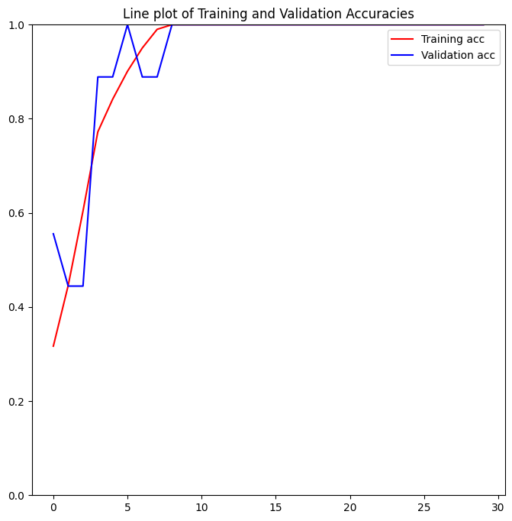
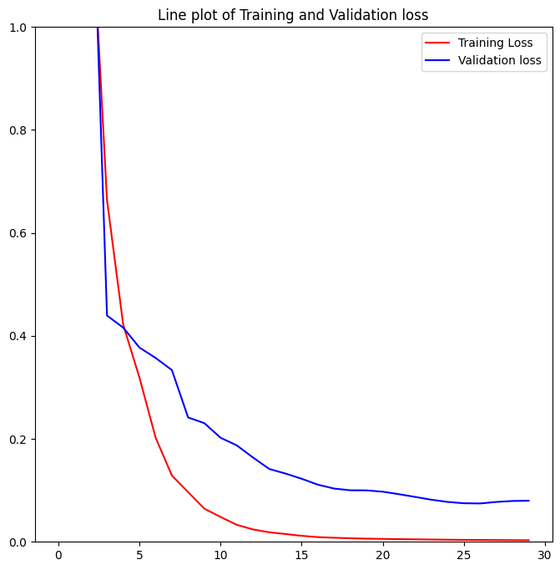
Algorithm Tuning
(Advanced Classes Only)
I have tuned my algorithm by creating and running the code .
I have used Hyper parameters like RESNET and MOBILENETv2
Epoch == 20
Learning rate == 0.001
Optimizer == optimizer adam
there gives the best result in the mobilenetV2.

Slide 7
Thank you

